Slide 1

Operation Manuel
01
Bowling Project
售后部2022-04-V01

Slide 2
02
一、Background Manu
Game Setup
1、How to get into the Background？
A：Touch Screen model: Keyboard F11 can enter and exit B. Press Red Bottom to enter for Joystick model
System Setup
2、How to get into Menu？
A：Keyboard ↑ ↓←→， B：Joystick model, Joy stick to choose, yes for confirm
Account Check
3、Tips
A：Press back when being gaming, will display standby screen
Encryption Code Setup
Equipment Debugging
About the game
Back

Slide 3
03
1、Game Setup
1、Free Game
Choose” yes” you can play for free，Chose “NO” you must insert coin or swipe card
Free Game yes
2、Strike Time
From 0S to 300S，set up according to your facility demands，must ≥20S
Strike Time 300S
3、Play Video
Choose “Yes”, TVE will display video when standby
Play Video NO
4、Volume
Background voice, music Volume, you can adjust as you like
Music Volumn 100%
Show product name NO
Input Player Name no
5 、Restore Defaults
Choose “ YES” then you will get into factory mode
Restore Defaults no
Back

Slide 4
04
2、System Setup
Machine NO 1
1、Machine Number
From Left to Right will be ：1、2、3、4、5、6、、、
Track NO Left
2、Left /Right track
Left is for left track, Right is for right track
String pin detection 4
3、String Pin Detection
Factory default pin string detection value，main for record scoring time and can not change
Strike Detection Time 2.5S
4、Strike Detection Time
The time of Ball pass through the Lane sensors
Motor Detection Time 0S
5、Motor Detection Time
Nomral is 0S，or Error
Restore Panel No
Technicial will set up all date and it’s better not change, or will be machine error
Restore Panel main for checking all information for techncials
Debugging Defaults NO
Back

Slide 5
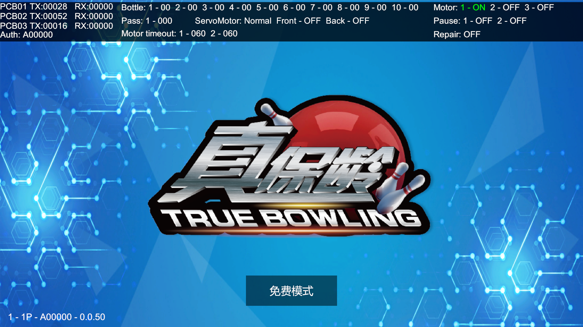
05
2.1、Restore Panel （Choose Yes will show following below display)
Area ①：
PCB01-03 link status, once communication successfully,，Tx and RX will be changing all the time
Auth: Encryption Code Time/Roll
Area ②：
Bottle:1-10 Sensor Counting ，The value will be changed when pins fall down
Pass :Lanes sensor count
Servo Motor: serve motor running status，Normal is ok.
Front/Back：Front and Back sensors for Pin Box status
Motor timeout1&2，Front and back Ball return machine count, now we set up as 0.
Area ③：
Motor 1&2&3, are Serve Motor’s power, dribble motor, and ball up status Pause 1&2，Front and Back e-stop
Repair: Maintain status, or you press e-stop will get this display
①
②
③
1<Machine NO>-1P<Player NO>-A00000<Encryption Code>-0.0.50<Game Version>

Slide 6
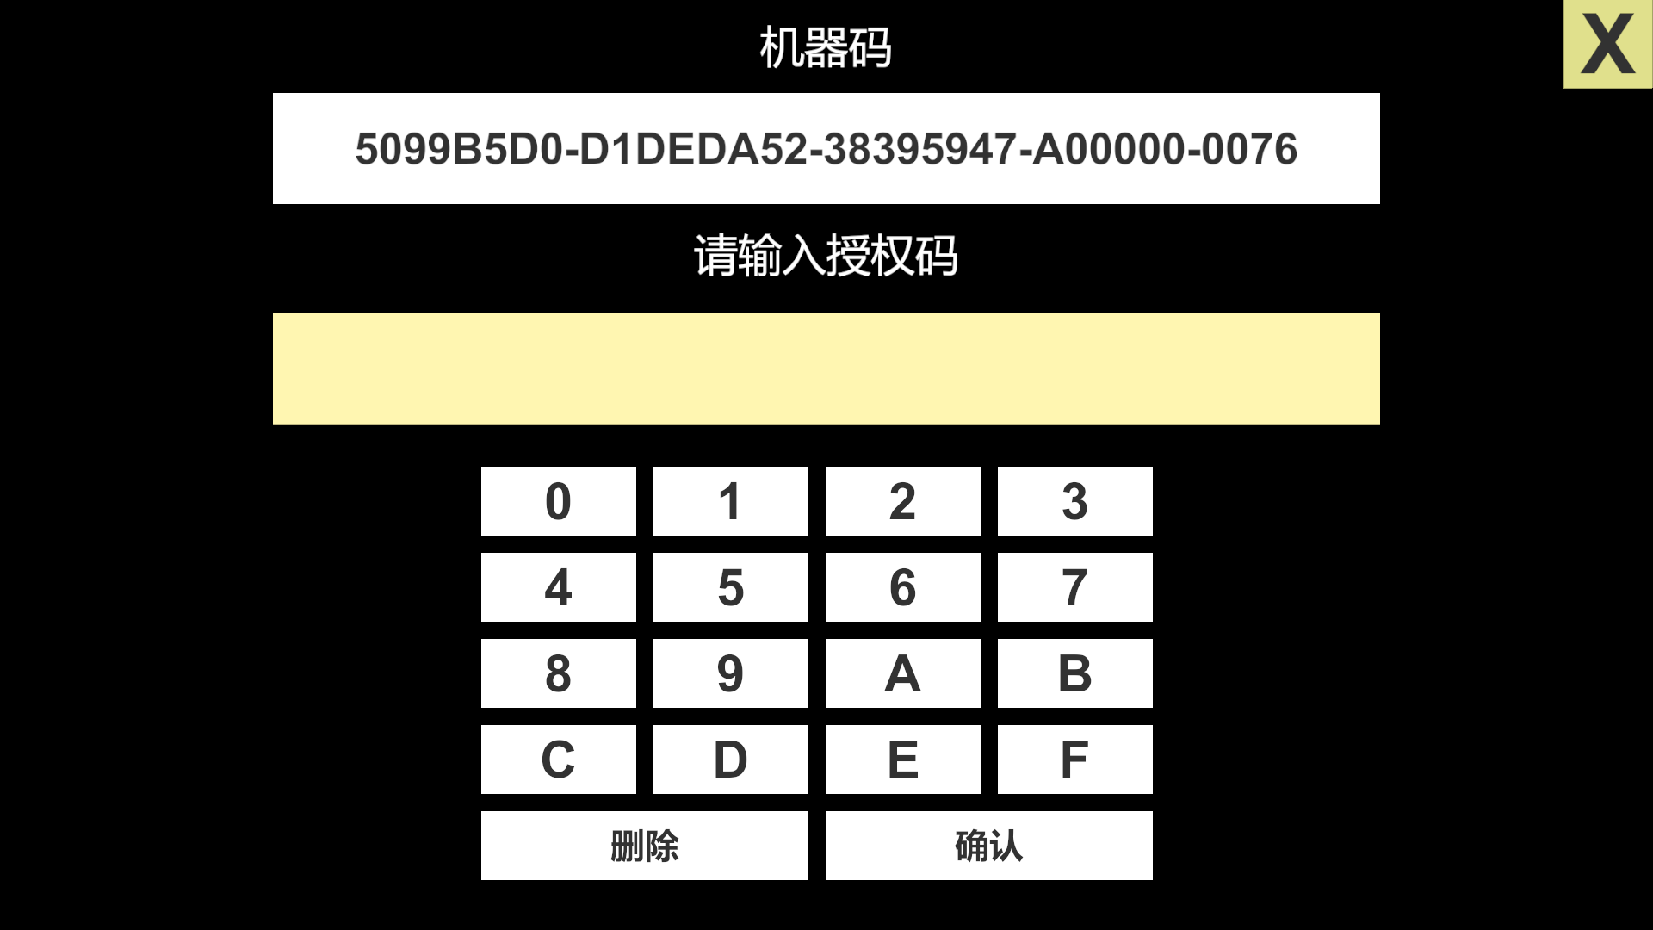
06
3、Account Check
4. Encryption Code Setup
When you get this display, pls contact with sales
Press new Code then you will get English Display

Slide 7
07
5、Equipment Debugging
Pin Box Detection
These are 3 parts for detection machine
Front Main Cabinet
Back Main Cabinet
Back

Slide 8
08
5.1、Pin Box Detection
1
21
2
21
3
21
4
21
5
21
6
21
7
21
8
21
9
21
10
21
Front sensor of Pin Box
OFF
Back Sensor of Pin Box
OFF
Pin Box Detection
Position
Unlock all
Lock all
position
1.String Adjust，Pins will up, during Pins Up sensors will count, which will check the first row sensors are workable or not; also can check all pins are in the same leveling, if not, pls adjust string by your hands.
2、Unlock All , press this bottom will unlock all pins.
3、Lock All，when pins fall to the ground or Hang in the air, you can press this will lock all and check the
electromagnet workable or not;
4、Position, Pins all fall down.位置原点，瓶子放下，感应片到前光眼返回一小段距离停下。

Slide 9
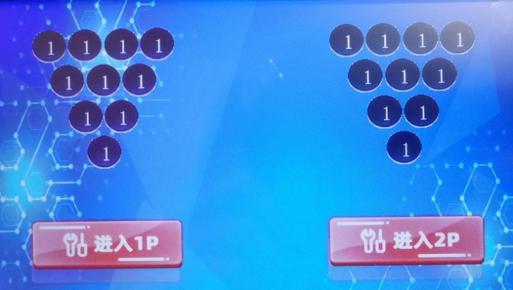
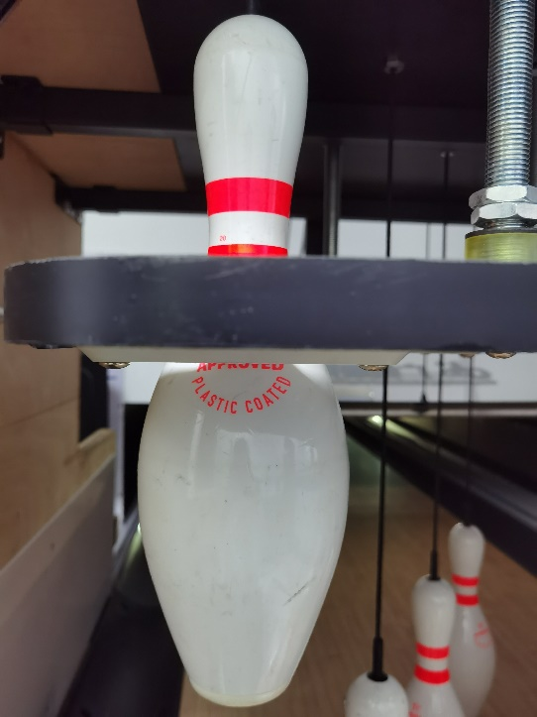
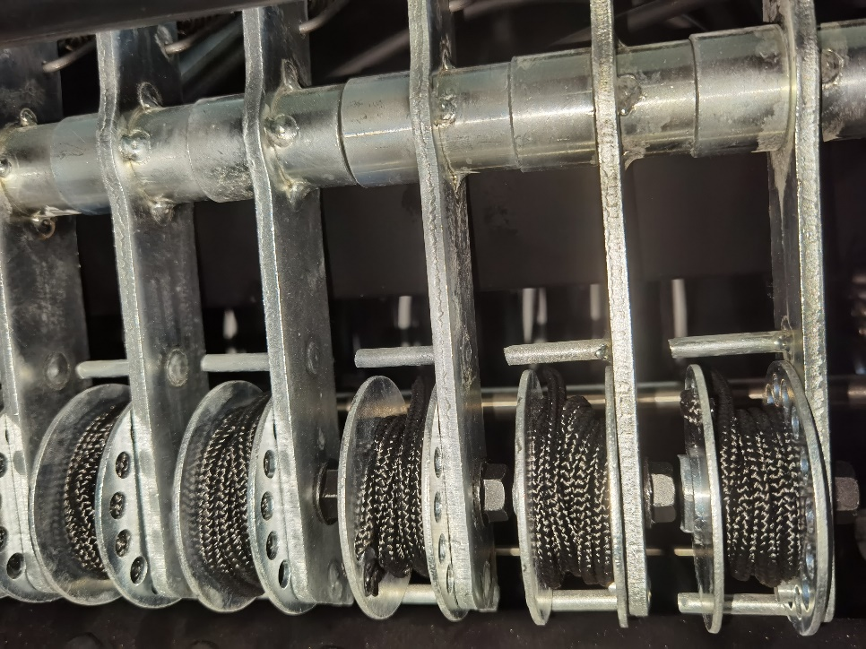
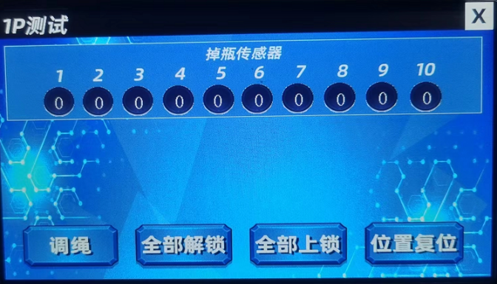
09
5.1.1、String Adjust
pic1
pic2
pic3
Choose 选择相应P位，进入调试面板如图1所示，点击调绳按钮，伺服电机会把瓶子拉起来停住，然后检查每个瓶子的位置是否顶到限位木板，如图2；若是没有顶到，则拉出图3中的轮子，往前转则瓶子上升（紧绳），往后转则瓶子下落（松绳）。把10个瓶子都调节到刚好顶住木板即可。

Slide 10
10
5.2、Front Main Cabinet Detection
Coin 1
Foul 1
Ball- in Sensor 1
Ball –out Sensor1
Protection Sensor 1
E-stop 1
Ball up motor Power Off
Coin Dispenser Power Off
Back
1、All RED words Now can not use ; pls not press.
2、Coin , E-stop：Coin in or press E-stop, both will count.
3、Ball up Motor Power: On then will be work
4、Coin Dispenser Power：you can choose ON and OFF.

Slide 11
11
5.3、Back Main Cabinet Detection
Track Sensor 1
Dribble Sensor 1
E-stop 1
Light Detection No
Once Press E-Stop, the light will keep 1 color, When Balls pass through tracks sensors, the light will change color; also can check lanes sensors workable or not, or you can use it when adjust lanes sensors angle.
Serve Motor Power ON
Dribble Motor Power Off
Buzzer Off
Back
1、Dribble Sensor Function can not use right now.
2、Serve Motor Power: Default ON.
3、Dribble Motor Power: ON. Dribble Motor will be work.
4、Buzzer：when you choose ON, machine will “DIDIDIDI”.

Slide 12
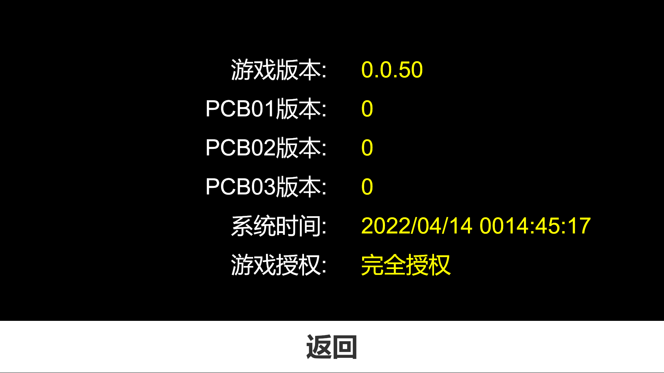
12
6、About the game
You can check the Game Version，PCB Version，Authorization Time and so on.

Slide 13
13
二、Game Rules and Game Play
Explanation
1、（STRIKE）：Hit Down all Pins in every frame’ first roll， symbol show：×
2、（SPARE）：First Roll not strike, but second roll strike , Symbol ：/
3、（FOUL）：Roll ball when Red light on, you foul , we cancel this function；
4、Overtime：Didn’t roll within strike time, then over time；
Scoring Rule
1、（STRIKE），Scoring=10scores+2 rolls’ scores behind 。
2、（SPARE），Scoring=10 scores+1 rolls’ scores behind 。
3、No strike, and no spare,，scoring=First roll+ second roll’s down pins of this frame
Game play
Time mode and Round Mode, just have these 2 modes

Slide 14
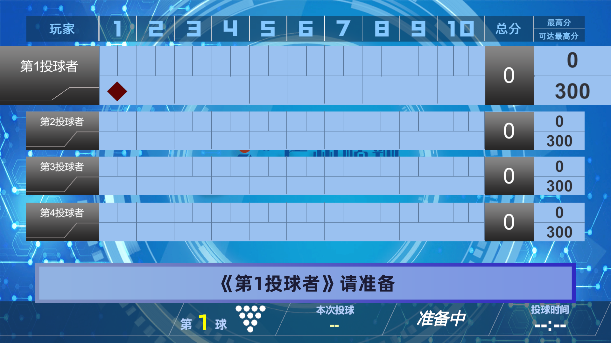
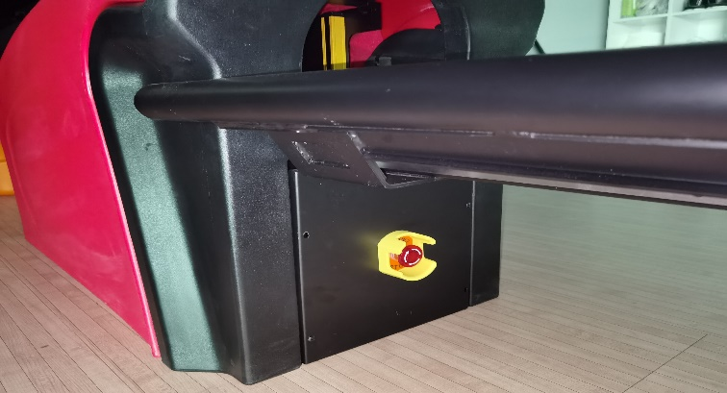
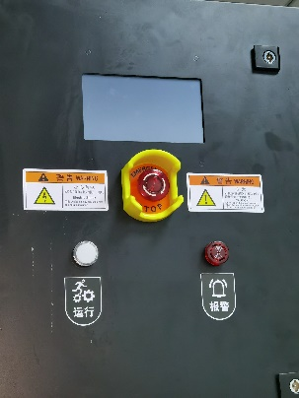
14
三、Game image display
Display following information：
1、Score
2、Hit how many pins
3、Player
4、Tips of throw
5、Time
6、Top Score
Cannot pause during gaming, unless press” E-stop” ; re-start it will back to game.
Any urgent cases pls press” E-Stop”

Slide 15
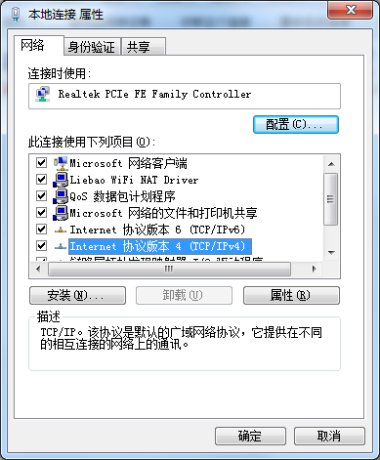
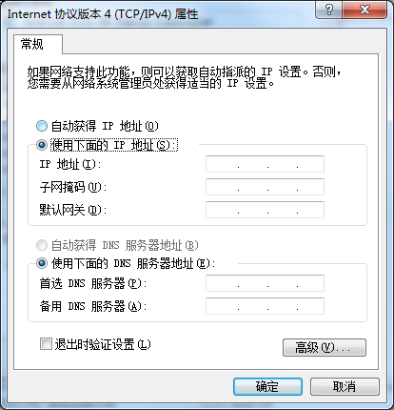
15
四、IP Setting Up
Usually no need set up IP, unless when Computer error;
This IP use for communication between Host computer and PCB board
Step：Start<control panel<网络和共享中心<本地连接<协议版本4
左球道IP地址（1P）：192.168.1.202 子网掩码：255.255.255.0
右球道IP地址（2P）：192.168.1.201 子网掩码：255.255.255.0

Slide 16
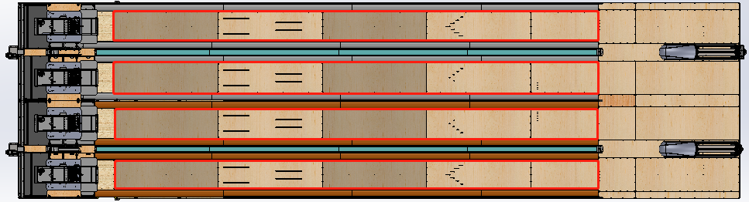
16
五、Equipment Maintaince
5.1 Oiling
Every 4 weeks oiling one time for the Track，just a thin file of Oil is ok to make sure Balls can be rolled. Following red area is Oiling Area.
5.2 Cleaning
。Every day clean and tidy Gutter and Capping, can not have any Debris which will scratch balls, Red Area also need clean 1 time every hand month or shorter time

Slide 17
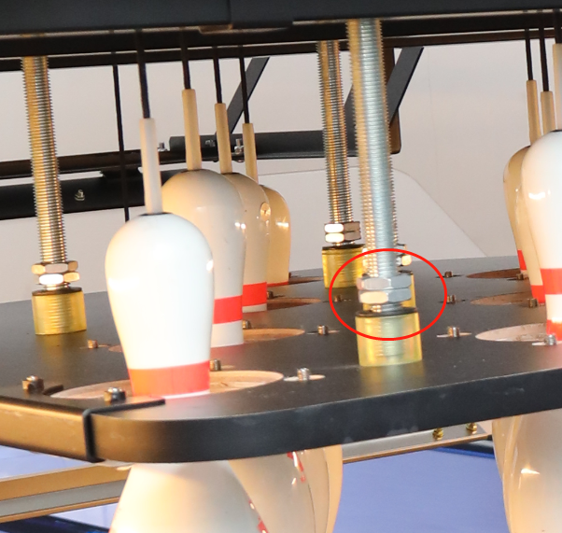
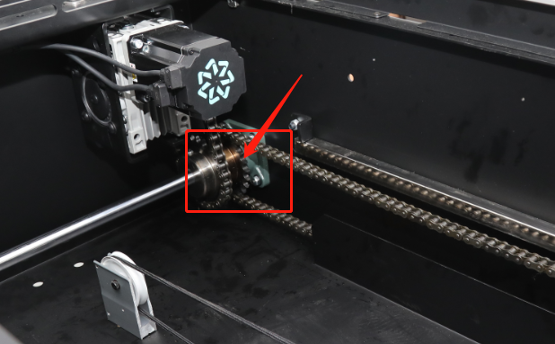
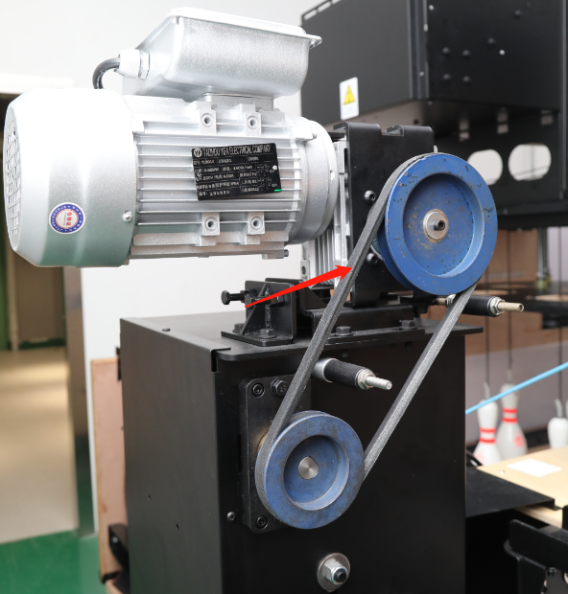
17
5.3 Adjust Strings
Every day adjust 3 times at least when starting using the machine, after some time you can adjust string every longer days.
When you need adjust string？
1、When10 Pins are not in the same levelling and pins drop on the ground not steady
2、when Twist string, must adjust string；
3、Pins can not Speed Cut when pins fall down, you need adjust pins now.
5.4 .Ball return Machine and Pin-pull checking
1、Every week need tighten screws because machine running will shock screws loose;
2、Apply machine oil or grease for chain or slider every month, scoring wheel also need apply oil;
3、Check any sundries or dropped screws on Machine, which will scratch balls, pls clean them. 4、Belt’s tightness is fit or not, too loose will be slipped, too tight will be burn motor when any stuck ，卡死异常的时候会导致烧电机。

Slide 18
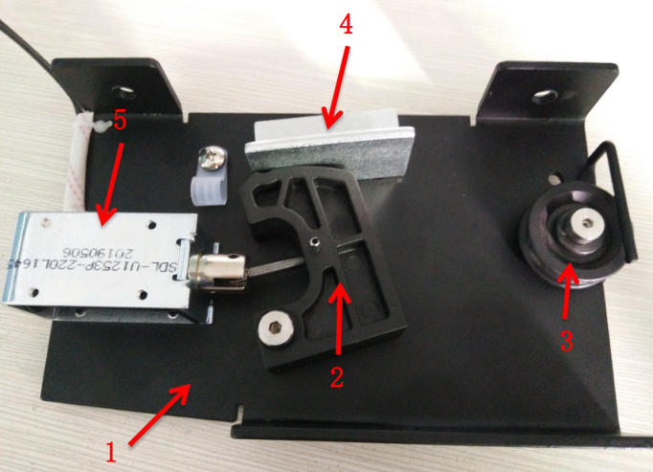
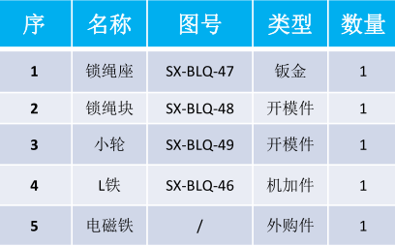
18
六、Faulty Fix
6.1 How to judge the communication is ok ?
Open Restore Panel from the background you can check the PCB boards’ linking status, you can check network port flashing or not, quick flashing is normal
6.2 Wrong Scoring
1、Check Scoring wheel can be twirled during pins are pulled，
if no twirled will be not checked by Scoring Sensors；
2、Exchange sensors' sockets to check sensors and extension board has
problem or not
6.3 Electromagnet can not lock
1、Electromagnet working voltage is 24V to test the Voltage is normal or not
2、If the voltage is normal 24V, pls check electromagnet core whether
has actuation , if no actuation then the electromagnet faulty,
3、If voltage is not 24v，pls check the extension board or pulling-pin box
voltage is 24V or not
4、Voltage is normal, electromagnet actuation still can not lock, pls check L model metal angle from Lock string structure is normal, or check the spring broken or not;
6.4 Electromagnet Dead Lock
Usually L metal angle is too larger to make dead-lock

Slide 19

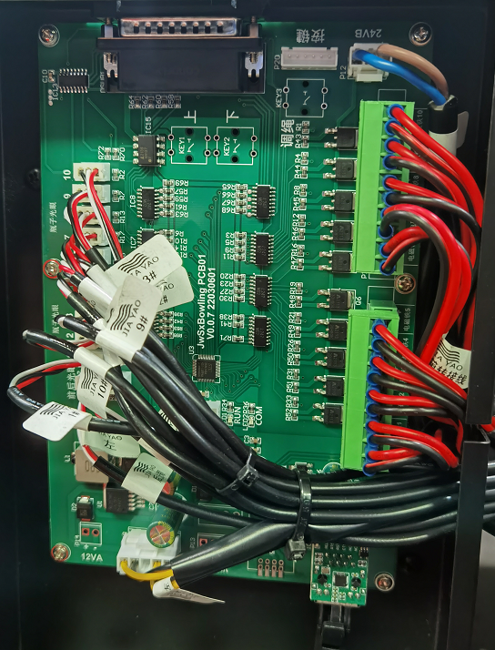
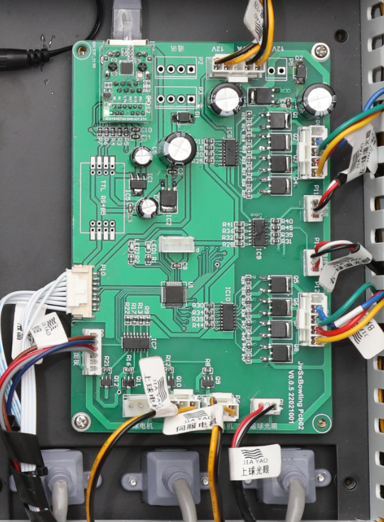
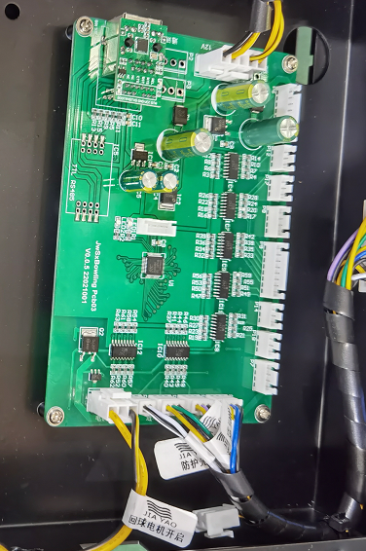
19
6.5 Error
Check PCB Board’s Work LED is normal or not, Network cable communication is normal，and the Network cable work LED flashing, network cable is link tightly or not
No.1（Pin-pulling Box）
No. 2（Electronic control panel）
No. 3（Ball return Machine）

Slide 20
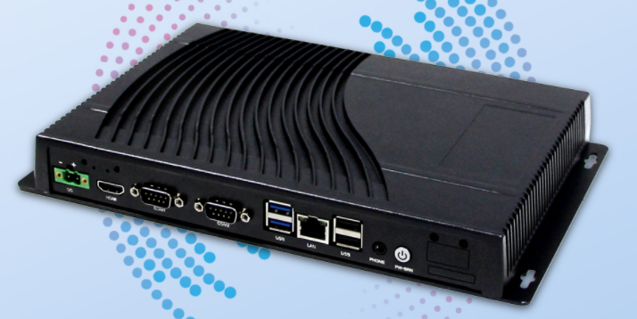

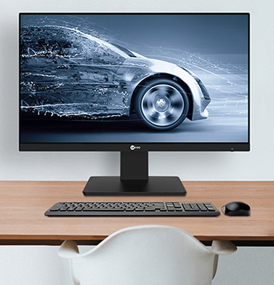

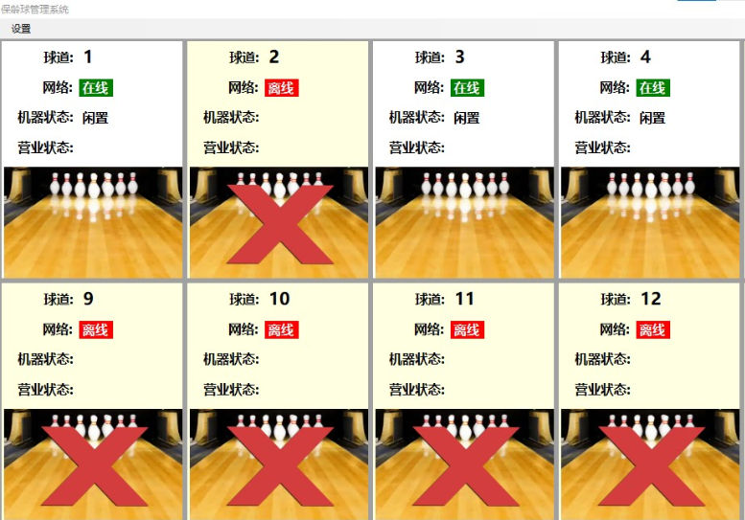
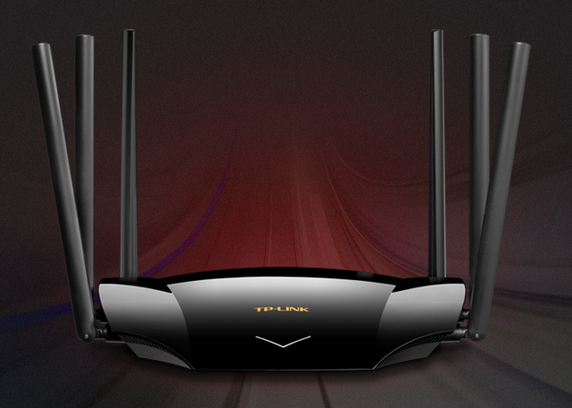
20
七、Management System Link and setting up)
7.1 Wiring Link
IP:192.168.2.1
密码：8888
IP:192.168.2.2
IP:192.168.2.3
IP:192.168.2.250
IP:192.168.2.4
Master Computer
Router/TP-LINK
1、Master computer can link with WIFI Router via net cable, slave computer need install wi-fi card to set up IP address , then link with Router
Machine
Computer
Wi-fi Card
2、Machine computer IP no will be 1、2、3、4、5、、、from left to right.
3、Router name as：Bowling Manager，Password：8888.Never change it！！！

Slide 21
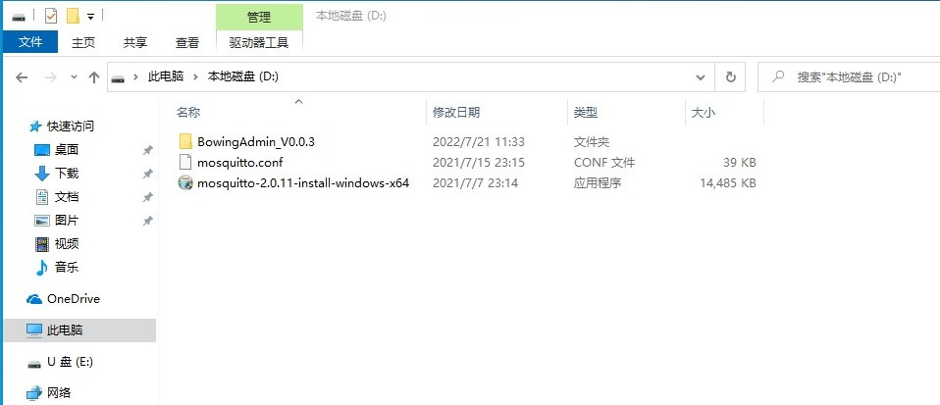
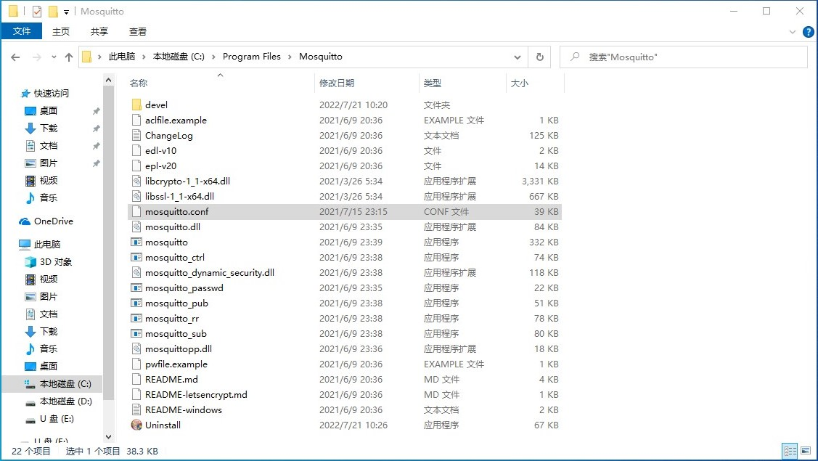
21
7.2 Central system installtion
1、Management System files saved in the Host Computer D Disk, pls install the 3rd file.
2、After 1st step, pls copy the 2nd file into C disk, Follow up: Program Files < Mosquitto Folder，then shutdown, re-start the computer.；
3、Open the first files”BowlingAdmin_V0.0.3”；

Slide 22
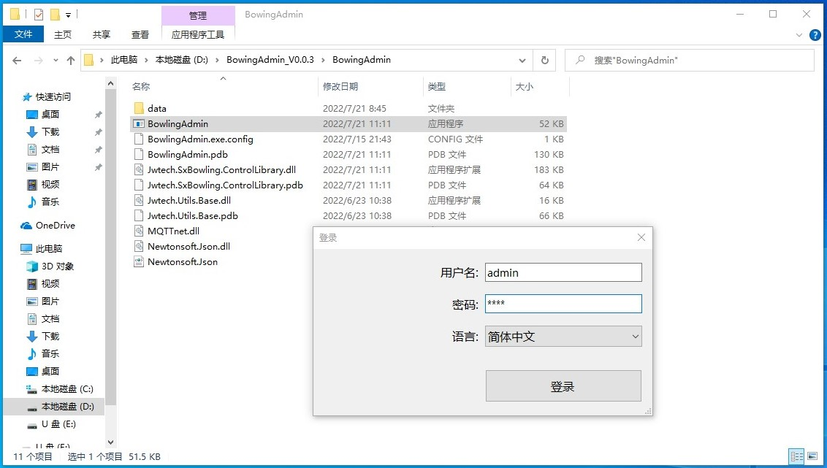
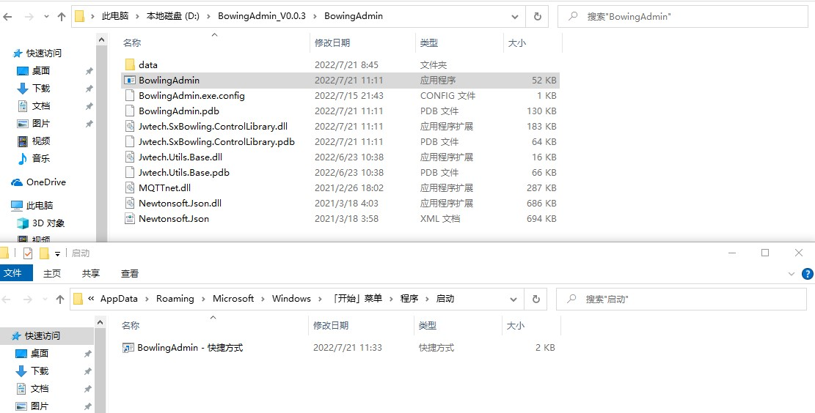
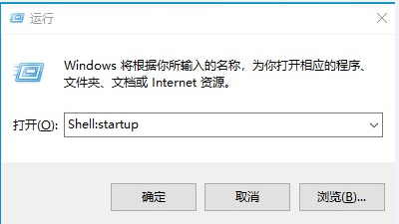
22
4、找到BowlingAdmin应用程序，创建一个快捷方式，并把快捷方式粘贴到启动菜单里面；
键盘Win+r可打开运行，输入：Shell:startup,可打开启动文件夹

Slide 23
23
5、Double Click”BowlingAdmin” application program, and open LOG IN”
6、Input user name：admin; Password：8888，Choose Language then you can log in.

Slide 24
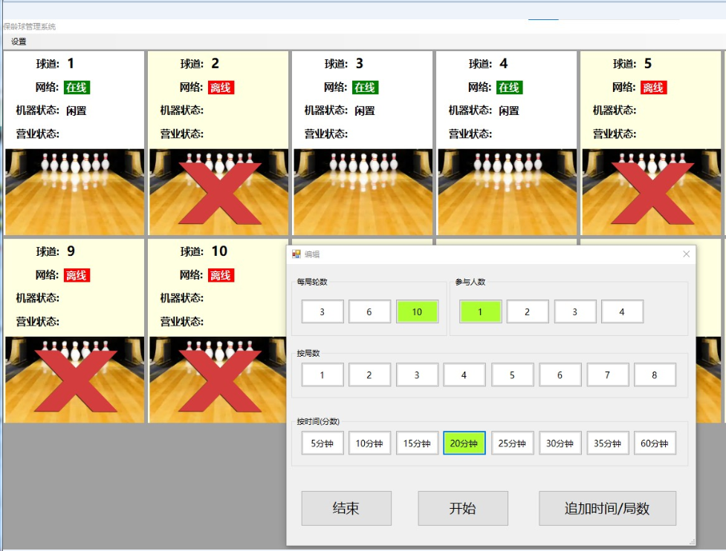
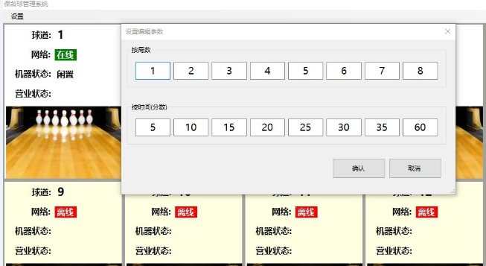
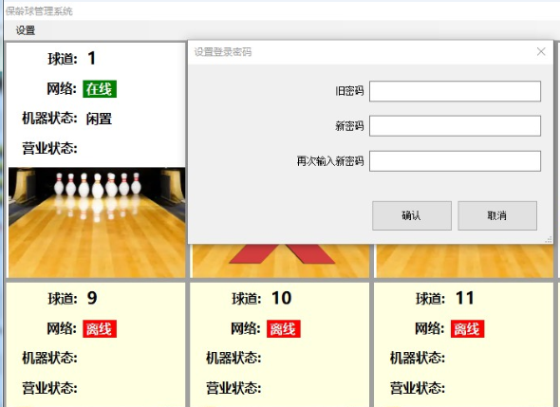
24
7.3 Operation Interface of Management SYSTEM
1、Click Left up “setup”, you can change Password, edit parameter（Round、Time）；
2、Click picture to choose Start/End, Adding, Gaming，Round and Time mode just can choose 1.

Slide 25
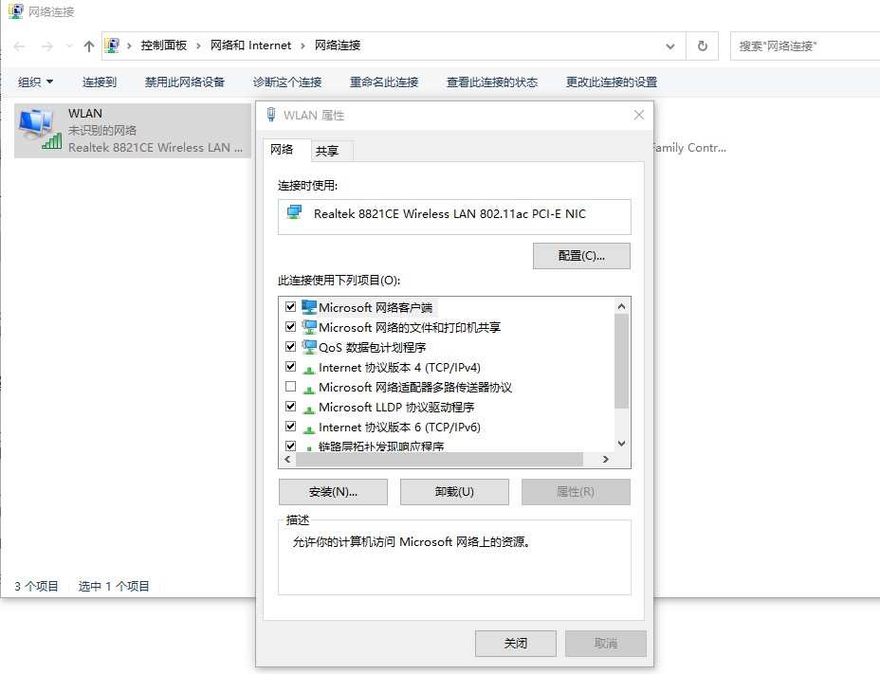
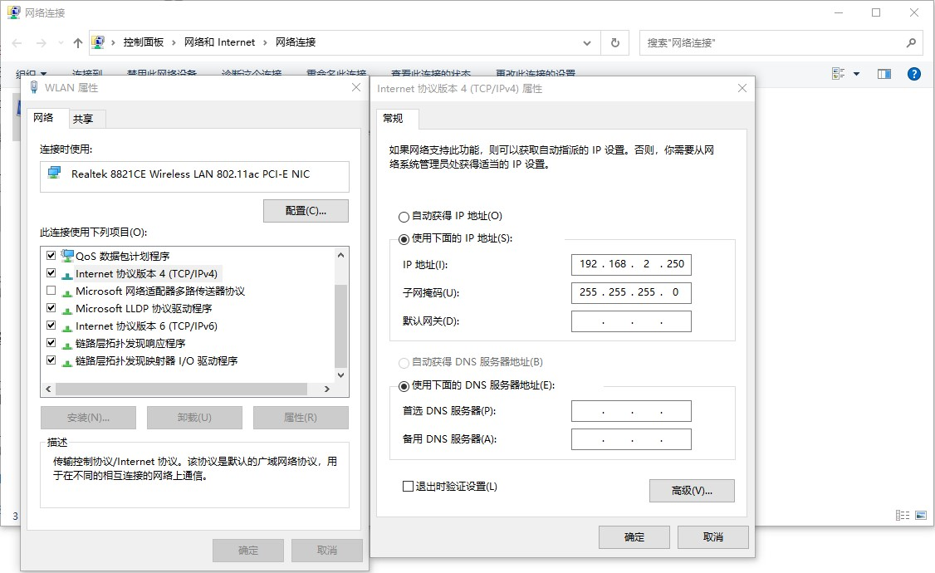
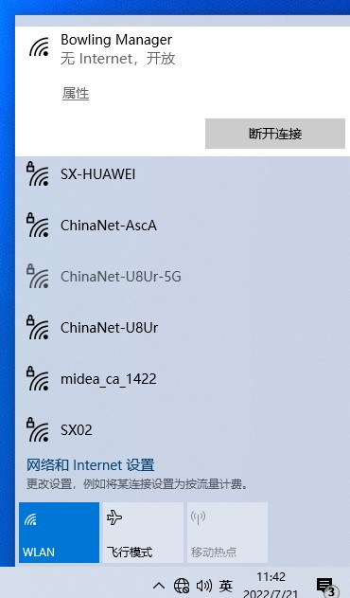
25
7.4 IP设置
1、Right down side pls choose link Router：Bowling Manager；
2、Go to network sharing to find the Router Wifi, right click Properties to choose IPV 4;
Master Computer IP is:192.168.2.250
1P (Lane 1)Computer IP is：192.168.2.1
2P(Lane 2) IP is ：192.168.2.2 … …all other lanes will be by parity of reasoning.

Slide 26
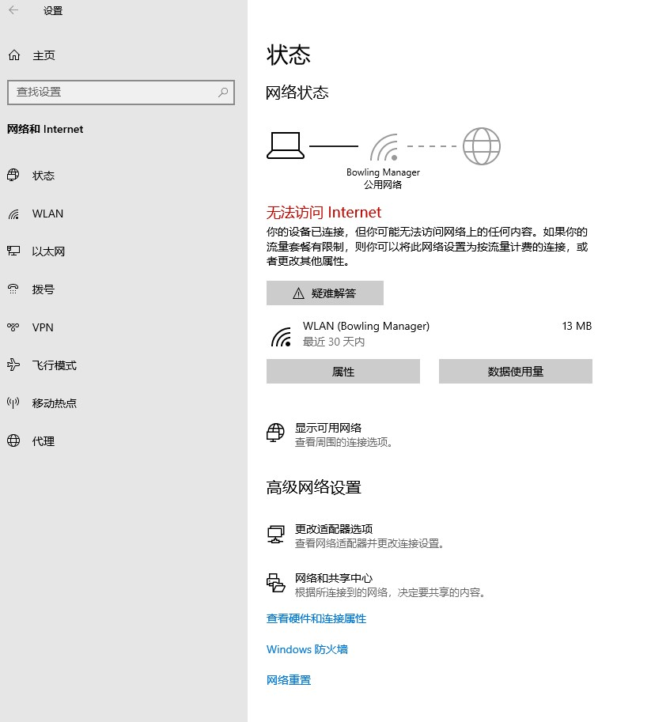
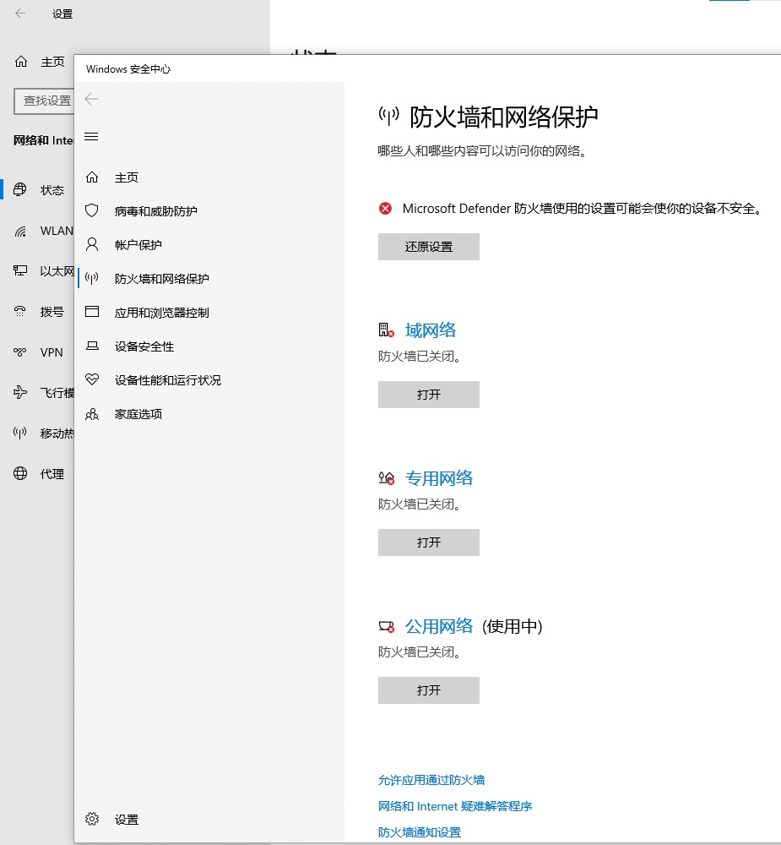
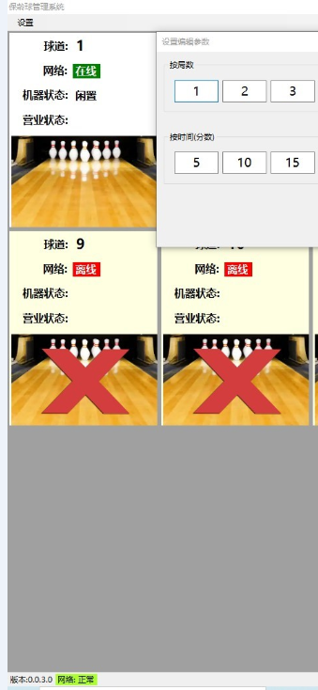
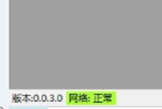
26
7.5 防火墙设置
Close all firewall to make sure master computer and link with lane’s computer successfully.
Soft left lower side show network connection status；
Master computer system must be Win10 *64 system;
Master computer cannot use for surf but just manage the lanes system;

Slide 27
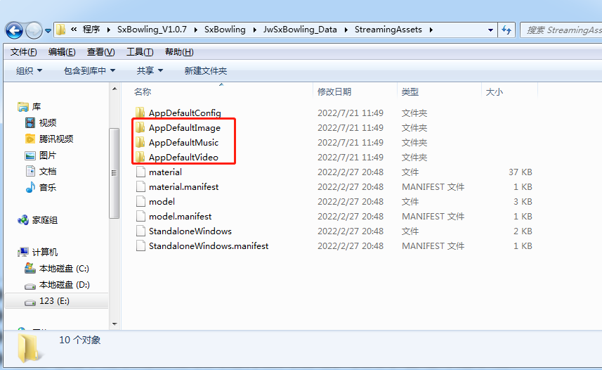
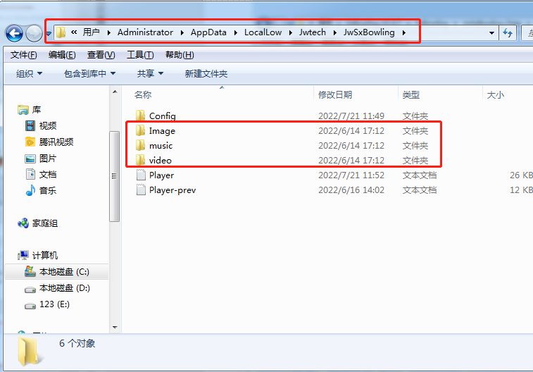
27
八、LOGO更换（须在球道主机中更换）
D盘
C盘
1、如图在D盘程序文件夹StreamingAssets文件夹下有三个文件夹，分别是：图片、音乐、视频；
2、客户可以根据需要自行替换，需求如下，注意名称和格式保持一致
# 游戏开启中图片 名称: start_company.jpg 图片格式为: 1920X1080 JPG格式
# 游戏过程中底图 名称: guest_name.png 图片格式为: 1920X1080 png格式
# 游戏开机/待机视频 名称: video, 视频格式为: 1920X1080 MP4格式, 长度10秒内
# 如果上面两者都不存在, 则默认广州顺翔为开机图片
注意 ：须同时进C盘文件夹中替换 ！！！

