Slide 1
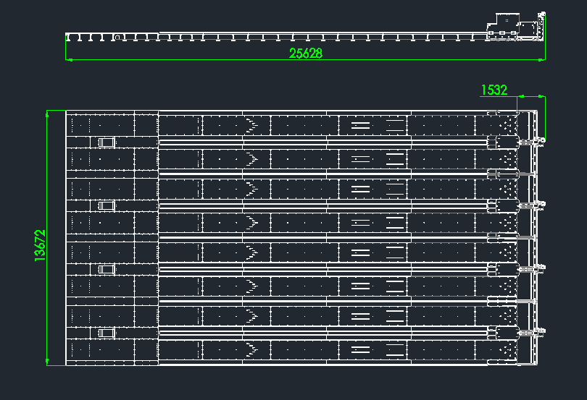
8道保龄球设备尺寸

Slide 2
弹线
边线
0
1
4
7
10
13
16
19
23
27
31
3423mm
3401mm
13648mm
中心线
3401mm
3423mm
761mm
2400mm
2400mm
2400mm
2400mm
2400mm
2400mm
2400mm
2400mm
2400mm
3100mm
间距800mm
间距600mm

Slide 3
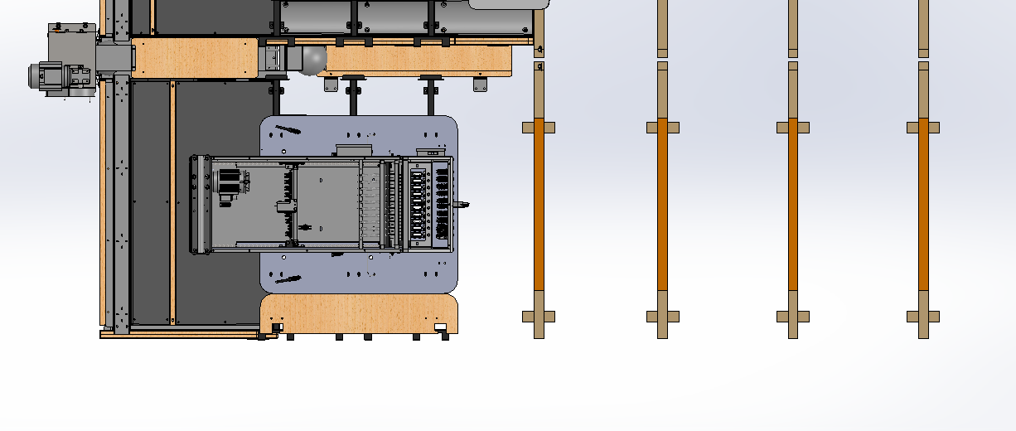
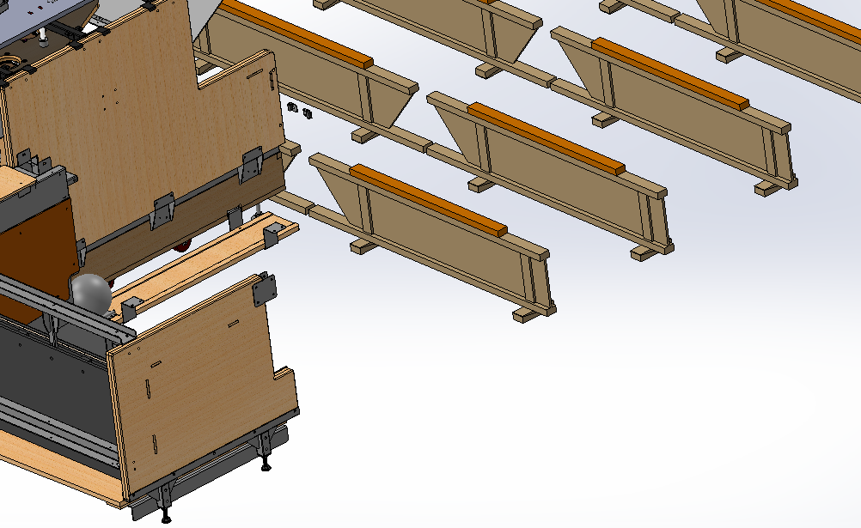
工字木尺寸线
0
1
2
3
761mm
800mm
800mm
800mm
761mm

Slide 4
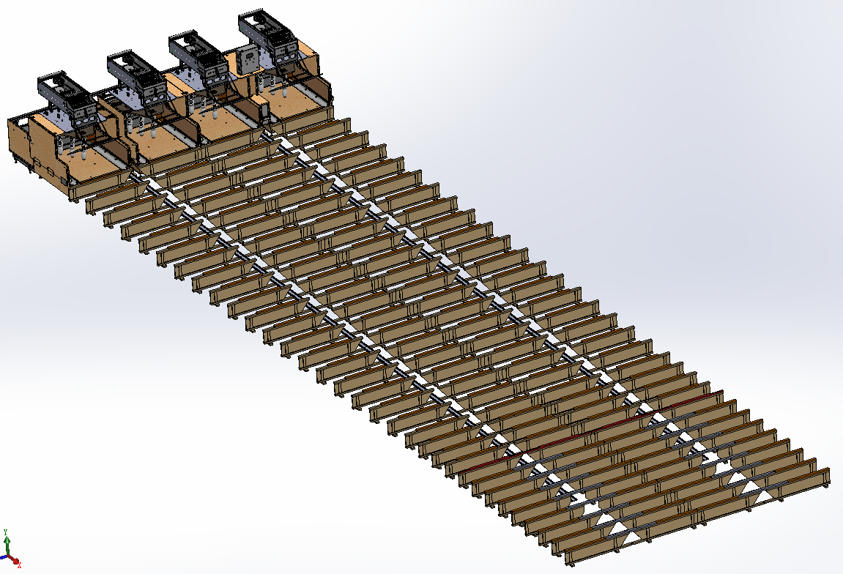
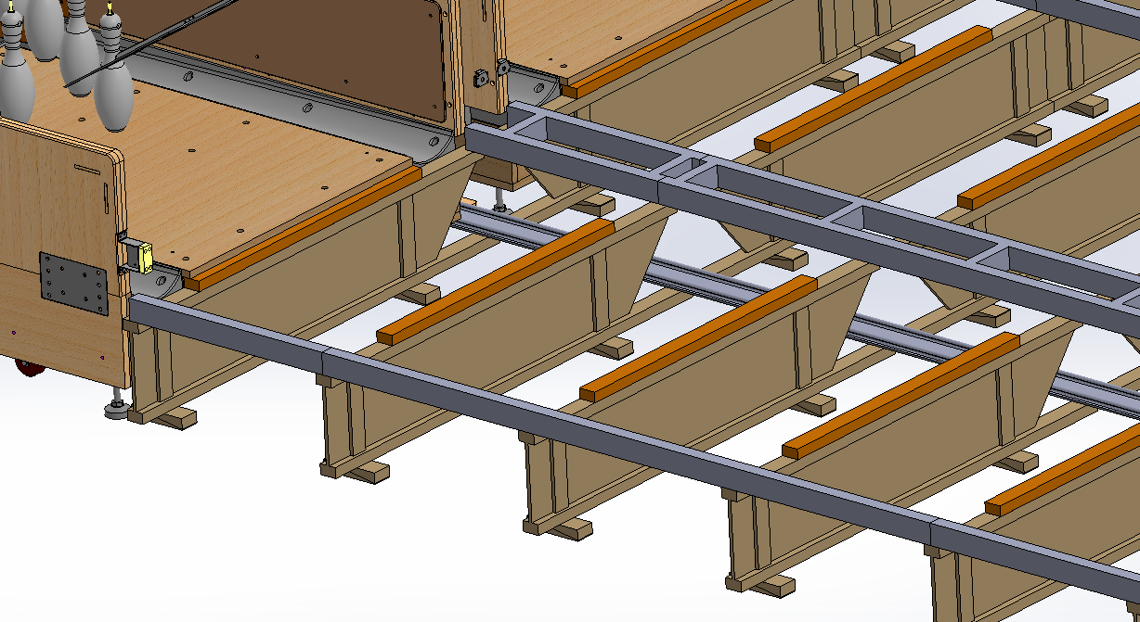
球道区垫木尺寸线
1060mm
23号工字木
犯规线

Slide 5
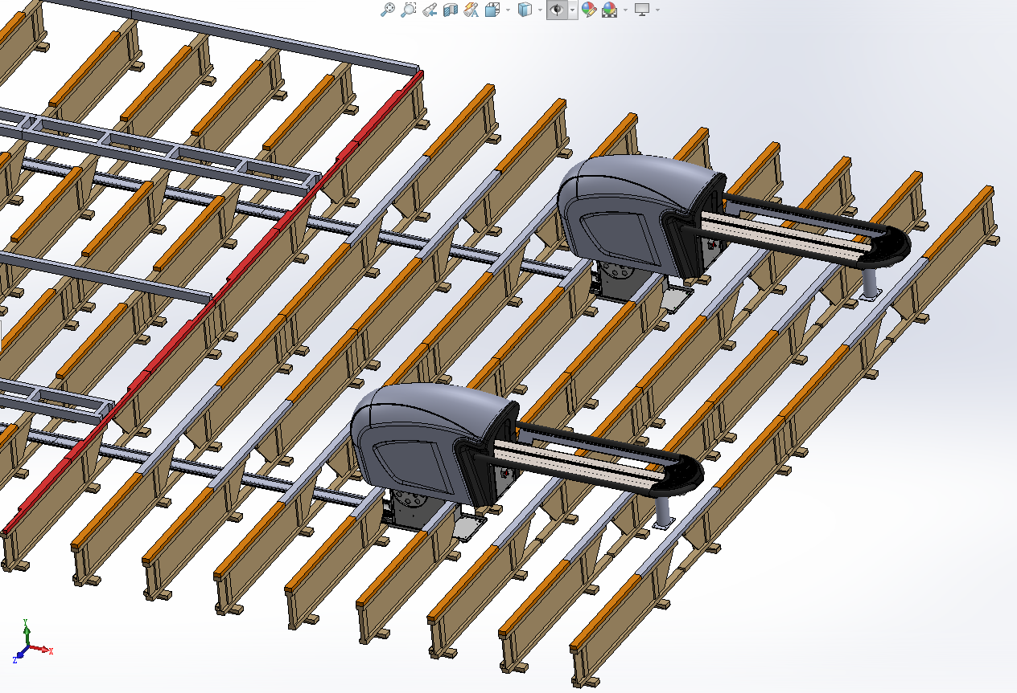
助跑区垫木尺寸线
1060mm
1300mm
1060mm
1060mm
1300mm
1060mm

Slide 6
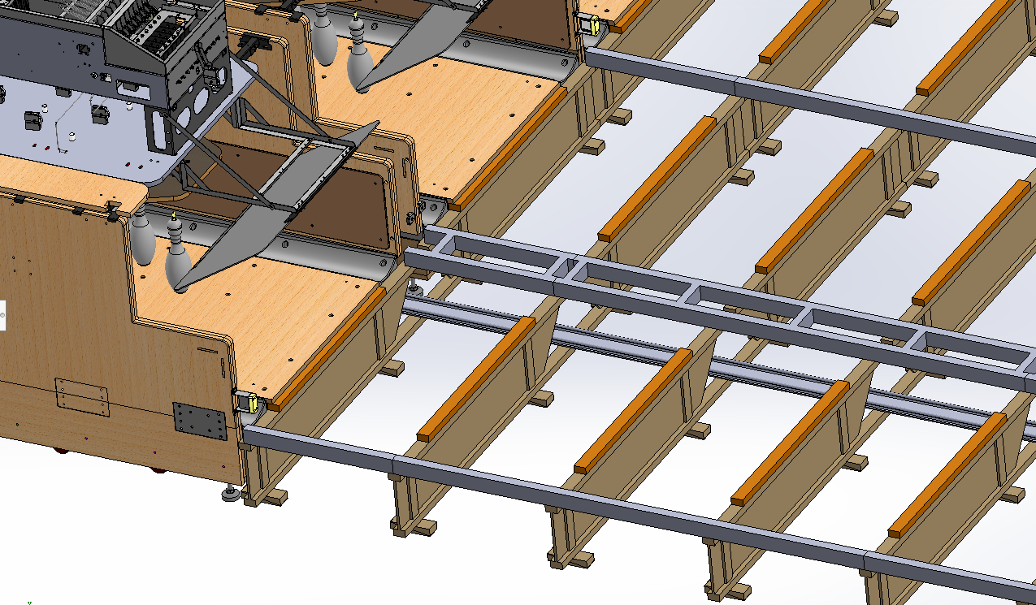
边木及中间框尺寸线
761mm
2400mm

Slide 7
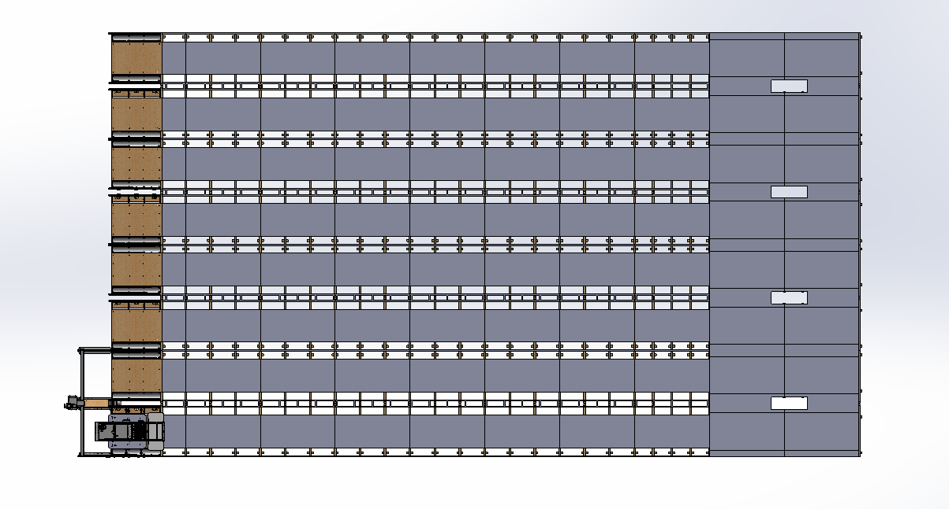
衬板尺寸线
1060mm
13648mm
761mm
2400mm
2400mm
2400mm
2400mm
2400mm
2400mm
2400mm
2400mm
2400mm

Slide 8
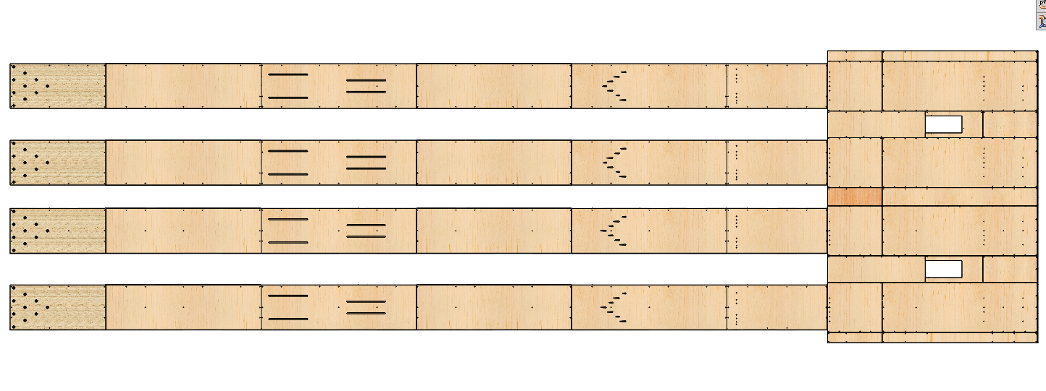
球道板尺寸
4920mm
1064mm
6868mm
2245mm
3640mm
3640mm
3640mm
3640mm
3640mm
3640mm

