Slide 2
2道设备占地尺寸
25735mm
维
修
区
设
备
区
3469mm
3102mm

Slide 3
弹线
0
1
4
7
10
13
16
19
23
27
31
边线
中心线
3445mm
761mm
2400mm
2400mm
2400mm
2400mm
2400mm
2400mm
2400mm
2400mm
2400mm
间距800mm
间距600mm

Slide 4
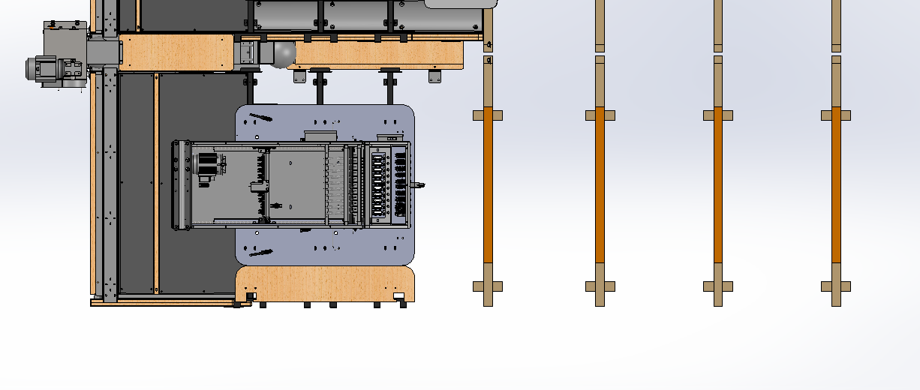
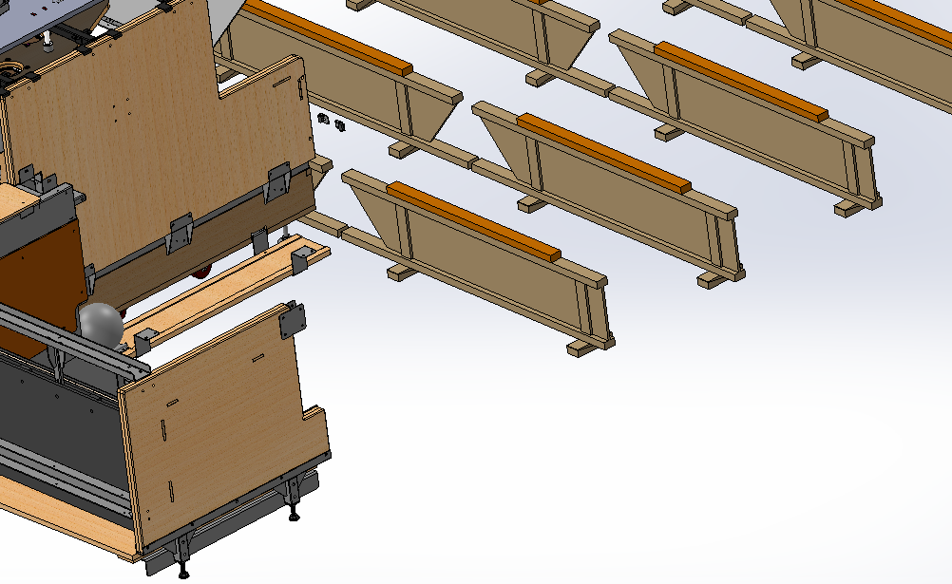
工字木尺寸线
0
1
2
3
761mm
800mm
800mm
800mm
761mm

Slide 5
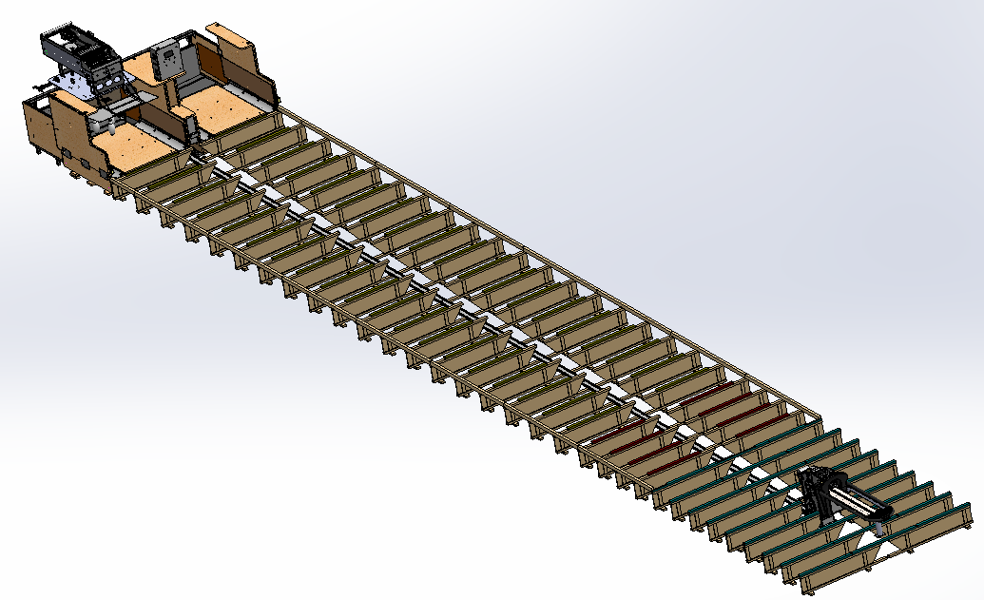
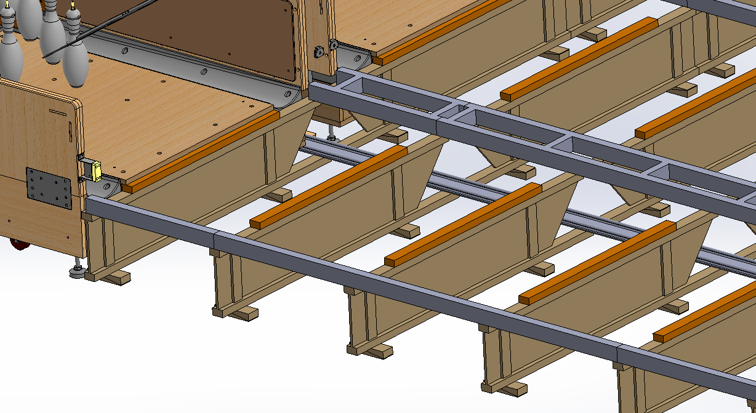
球道区垫木尺寸线
1060mm
23号工字木
犯规线

Slide 6
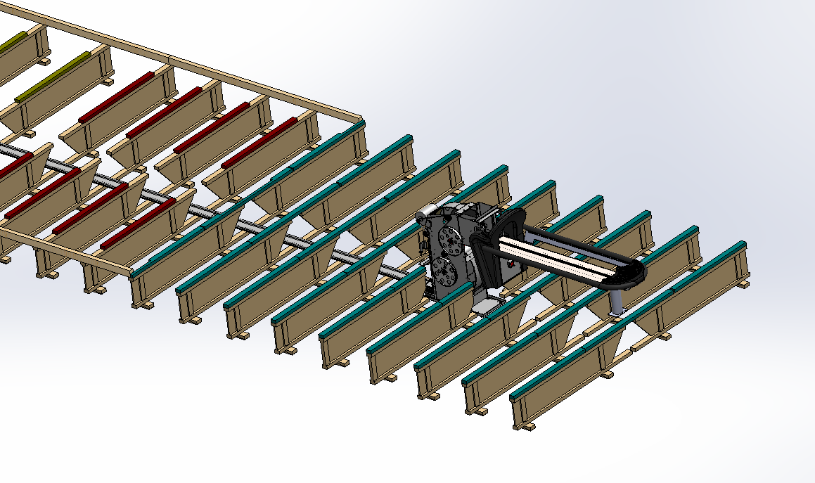
助跑区垫木尺寸线
1060mm
1060mm
1300mm
1060mm

Slide 7
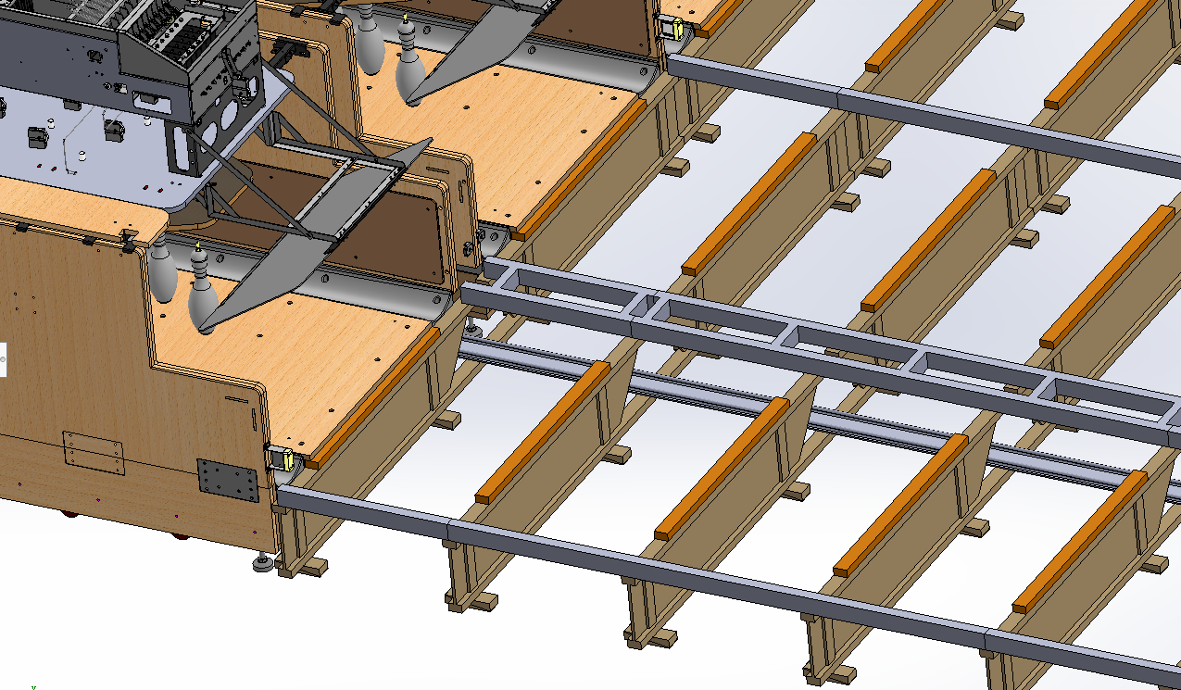
边木及中间框尺寸线
795mm
2400mm

Slide 8
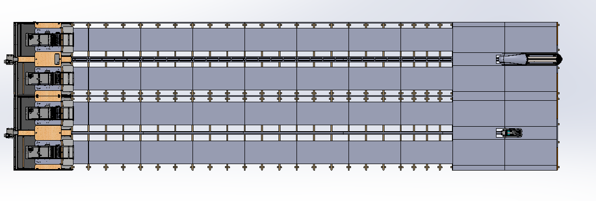
衬板尺寸线
1060mm
3445mm
761mm
2400mm
2400mm
2400mm
2400mm
2400mm
2400mm
2400mm
2400mm
2400mm

Slide 9
球道板尺寸
4920mm
1064mm
3469mm
2245mm
3640mm
3640mm
3640mm
3640mm
3640mm
3640mm

